Slide 1
Chapter-7
Basic Elements of Planning and Decision Making
7–<number>

Slide 2
Decision Making and the Planning Process
Decision making
  Is the cornerstone of planning.
  Is the catalyst that drives the planning process.
  Underlies every aspect of setting goals and formulating plans.
Planning
  All organizations plan, but not in the same fashion.
  All planning occurs within an environmental context.
  All goals require plans to guide in their achievement.
  All goals are tied higher goals and plans
7–<number>

Slide 3
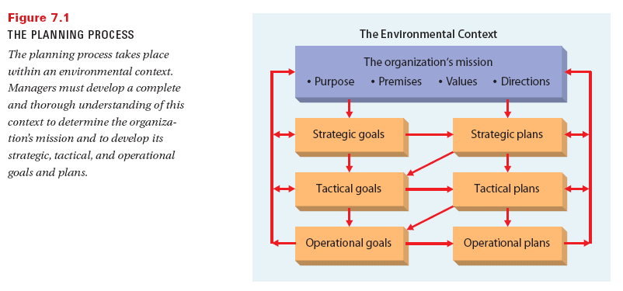
Figure 7.1: The Planning Process
7–<number>

Slide 4
Organizational Goals
Purposes of Goals
  Provide guidance and a unified direction for people in the organization.
  Strongly affect on the quality of other aspects of planning.
  Serve as a source of motivation for employees.
  Provide a mechanism for evaluation and control of the organization.
7–<number>

Slide 5

Kinds of Goals
By Level
  Mission statement
  Strategic goals
  Tactical goals
  Operational goals
By Area
  Different functional areas of the organization.
By Time Frame
  Long-term, intermediate-term, or short-term time frames and explicit time frames or open-ended.
7–<number>

Slide 6
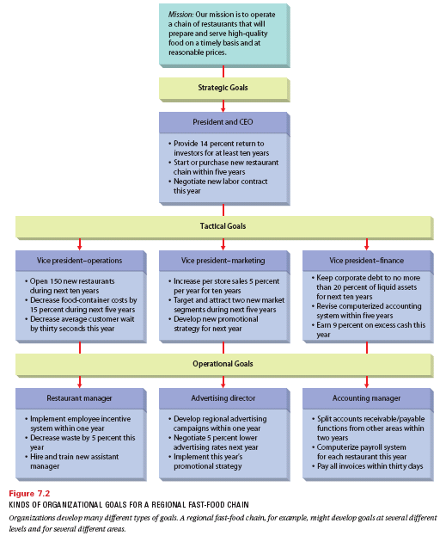
Figure 7.2: Kinds of Organizational Goals for a Regional Fast-Food Chain
7–<number>

Slide 7

Responsibilities of Setting Goals
Who Sets Goals?
  All managers: managerial responsibility for goal setting should correspond to the manager’s level in the organization.
Managing Multiple Goals
  Optimizing allows managers to balance and reconcile inconsistent or conflicting goals.
    Managers can choose to pursue one goal and exclude all others or to seek a mid-range goal.
7–<number>

Slide 8
Kinds of Organizational Plans
Strategic Plans
  A general plan set by and for top management that outlines resource allocation, priorities, and action steps to achieve strategic goals.
Tactical Plans
  A plan aimed at achieving the tactical goals set by and for middle management.
Operational Plans
  Short-term focus plans that are set by and for
  lower-level managers.
7–<number>

Slide 9
Time Frames for Planning
The Time Dimension of Planning
  Planning must provide sufficient time to fulfill the managerial commitments involved.
Long-range Plans
  Cover present and future strategic issues extending beyond five years in the future.
Intermediate Plans
  Cover from 1 to 5 years and parallel tactical plans.
  Are the principal focus of organizational planning efforts.
Short-range Plans
  Are action plans and reaction (contingency) plans that have a time frame of one year or less.
7–<number>

Slide 10
Responsibilities for Planning
Planning Staff
  Gather information, coordinate planning activities, and take a broader view than individual managers.
Planning Task Force
  Created when the organization wants a special circumstance addressed.
Board of Directors
  Establishes corporate mission and strategy.
  May engage in strategic planning.
Chief Executive Officer
  May serve as president or board chair; has a major role in planning and implementing the strategy.
7–<number>

Slide 11


Responsibilities for Planning (cont’d)
Executive Committee
  Composed of top executives.
  Meets regularly with the CEO to review strategic plans.
Line Management
  Have formal authority and responsibility for management of the organization.
  Help to formulate strategy by providing information.
  Responsible for executing the plans of top management.
7–<number>

Slide 12
Contingency Planning and Crisis Management
Contingency Planning
  The determination of alternative courses of action to be taken if an intended plan is unexpectedly disrupted or rendered inappropriate.
  These plans help managers to cope with uncertainty and change.
Crisis Management
  The set of procedures the organization uses in the event of a disaster or other unexpected calamity.
7–<number>

Slide 13
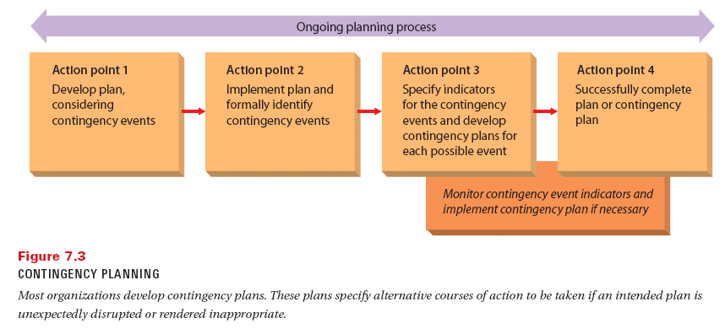
7–<number>

Slide 14
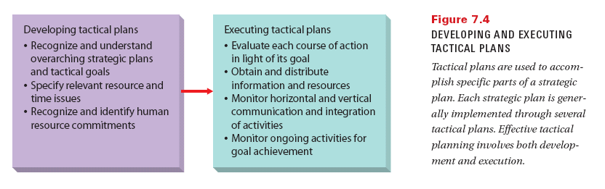
Figure 7.4: Developing and Executing Tactical Plans
7–<number>

Slide 15
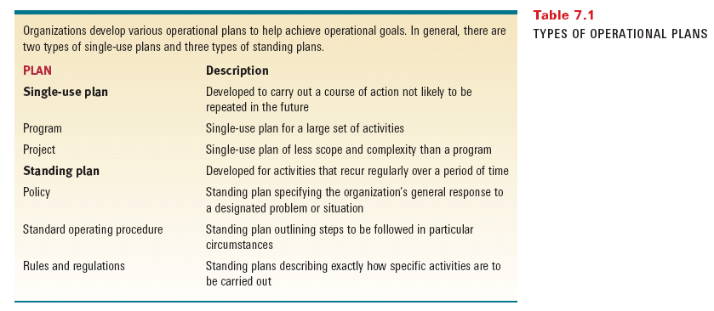
Table 7.1: Types of
Operational Plans
7–<number>

Slide 16
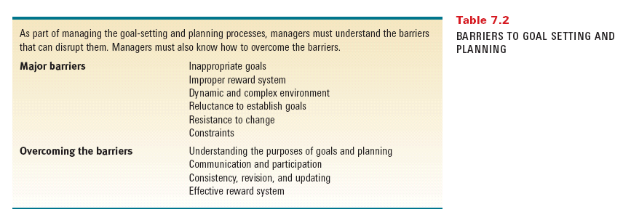
Table 7.2: Barriers to Goal Setting and Planning
7–<number>

